Slide 1
MONOD: Methylation Haplotype in non-invasive Cancer Diagnosis
Shicheng Guo @ Zhang Lab
July 22 2015

Slide 2
MONOD: Methylation Haplotype in non-invasive Cancer Diagnosis
Background
Material and Method
Result
Conclusion
Discussion

Slide 3
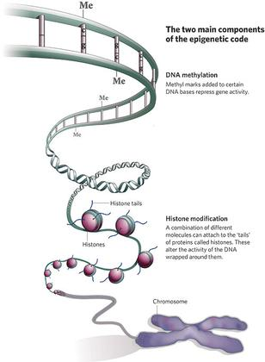
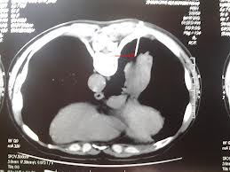
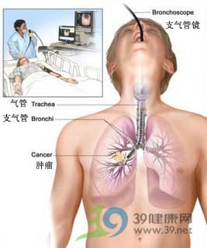
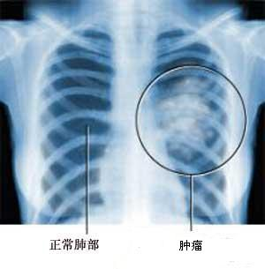
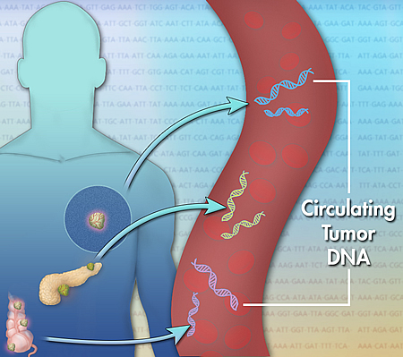
Background: DNA methylation in Cancer Diagnosis
Early Detection
Non-invasive
Prognosis
Surveillance
Drug Selection

Slide 4
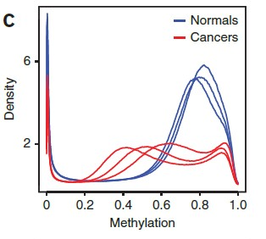
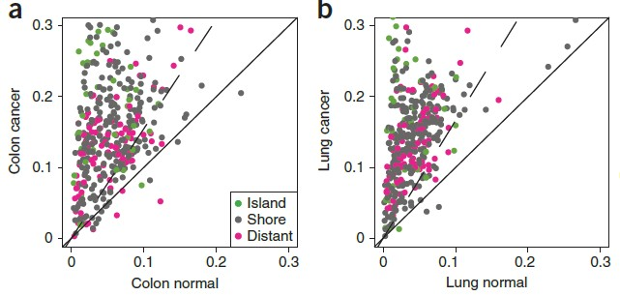
Genome-wide DNA methylation change in cancer genomes
Genome-wide hypomethylation in cancer genome
Methylation variation explain cancer heterogeneity
Drug resistance
Overall-survival-time
Hansen KD, et al. Nature genetics. 2011;43(8):768-75.

Slide 5
MONOD: Methylation Haplotype in non-invasive Cancer Diagnosis
Background
Material and Method
Result
Conclusion
Discussion

Slide 6
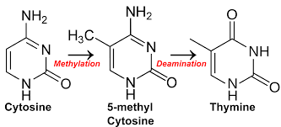
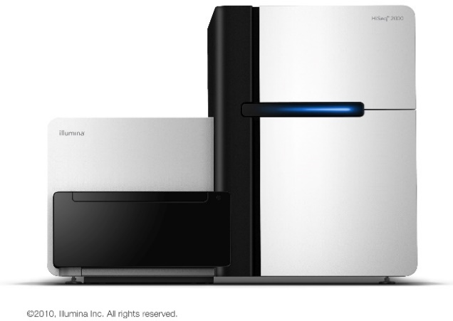
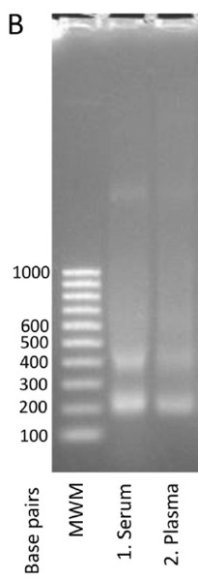
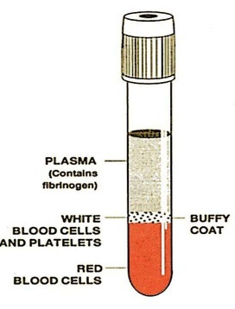
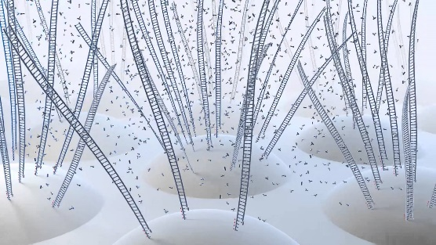
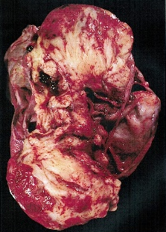
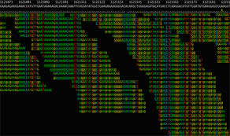
Pipeline
Solid Tissues
Plasma Collection
DNA Extraction
Bisulfite Conversion
DNA Sequencing
Alignment
Quality Control
Haplotype inference
Missing value imputation
Feature Selection
Validation
Sequencing Library: RRBS, BSPP

Slide 7
Samples
Cancer:
Normal:
15 primary lung cancer solid tissues and 10 plasma (5 overlapped)
15 primary Colon cancer solid tissues and 10 plasma (5 overlapped)
15 primary Pancreatic cancer solid tissues and 10 plasma (5 overlapped)
30 plasma from health individuals
N37: 37 normal tissues form Jin Billy Li, Standford Univ
Aging: WB_new-born, WB_middle-age, WB_centenarian
Structure
July 2014
Sep 2014
Dec 2014
Feb 2015
Feb 2015
RRBS
dRRBS
WGBS1
WGBS2
BSPP
68 Cancer
8 Normal
0 Cancer
17 Normal
19 Cancer
1 Normal
31 Cancer
24 Normal
16 Cancer Plasma
16 Normal Plasma

Slide 8
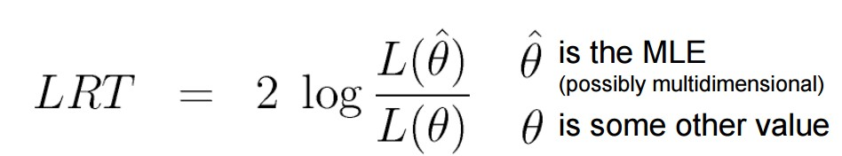
Methylation Haplotype Loading
Methylated Haplotype
Shoemaker R, Deng J, Wang W, Zhang K. Allele-specific methylation is prevalent and is contributed by CpG-SNPs in the human genome. Genome research. 2010;20(7):883-9
Likelihood-ratio test
Monte Carlo sampling/permutation
P(A)=1-P(x<a)
LRT has a Chi-Square Distribution

Slide 9
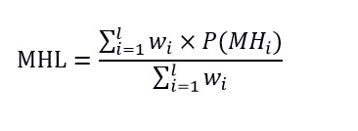
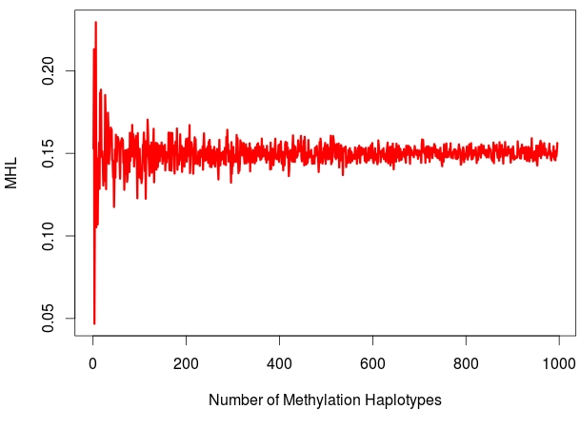
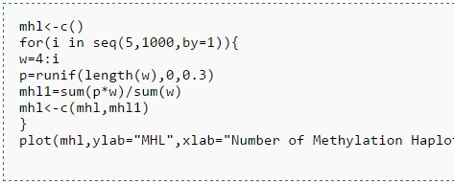
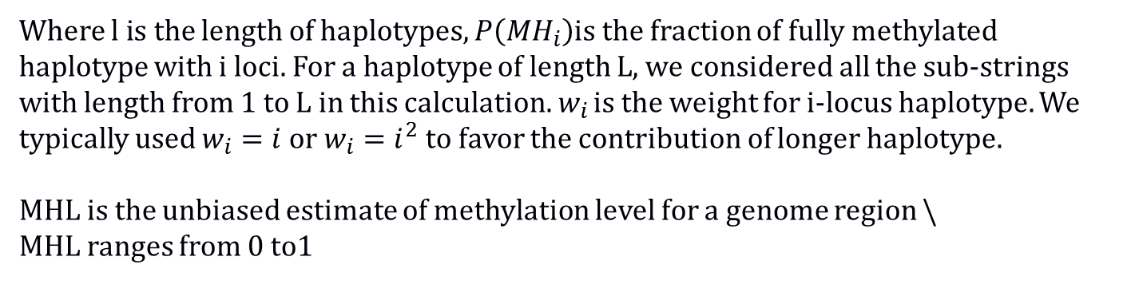
Methylated Haplotype Loading (MHL) for a genome region
Where $l i$s the length of haplotypes, $P\left({MH}_{i}\right)$is the fraction of fully methylated haplotype with i loci. For a haplotype of length L, we considered all the sub-strings with length from 1 to L in this calculation. $w_{i}$ is the weight for i-locus haplotype. We typically used $w_{i}=i$ or $w_{i}=i^{2}$ to favor the contribution of longer haplotype.
MHL is the unbiased estimate of methylation level for a genome region \
MHL ranges from 0 to1

Slide 10
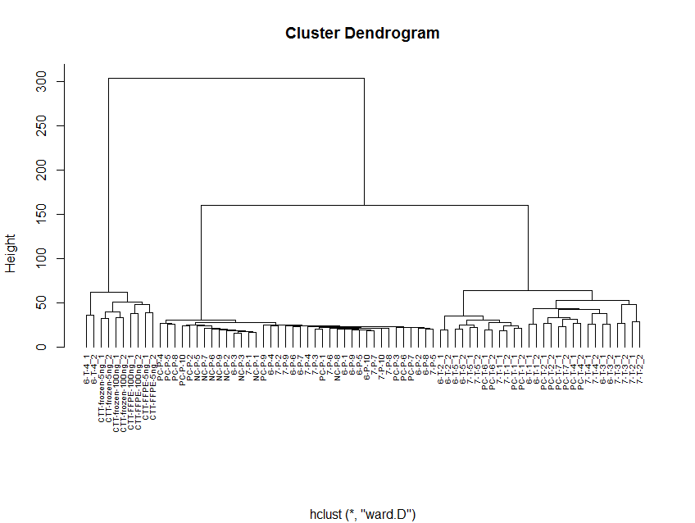
56046
Genome-wide MHL Profile Indicates Different Sample Types and Sample Status
RRBS Dataset: 50646 MHRs
Long Storage Plasma Solid Tissue
Accuracy:80% Accuracy:100% Accuracy:100%
Result: Cluster analysis showed genome-wide MHL based on RRBS dataset could distinguish sample size with very high accuracy. Cluster analysis were conducted with euclidean distance and ward agglomeration.
Notes:
Data: RRBS MHL data
Process:Raw data, no center and no scale
Distance fumula:euclidean
agglomeration method: ward

Slide 11
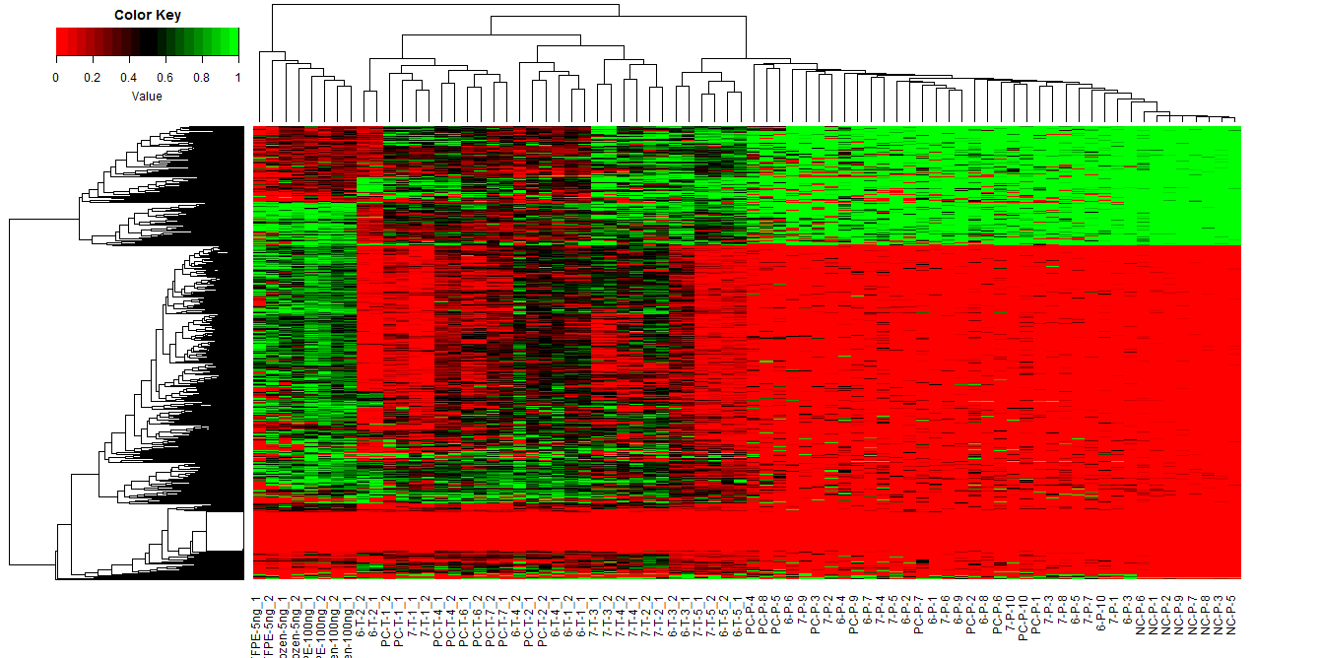
Differential MHL region Profile Indicate Different Sample Types
843 Significant MHL regions
ACC: Accuracy
FFPE Solid Tissue Cancer Plasma Normal Plasma
ACC=80% ACC=100% ACC=100% ACC=100%
Result: Methylation Haplotype Loading is informative to indicate sample type and sample status

Slide 12
Principle Component Analysis reveal the relationship between samples
based on RRBS dataset
The first principle component is significantly larger than the other PCs indicating certain factor might highly variant among the samples
Sample status of cancer or normal could be clearly separated in the PC1-PC2 space

Slide 13
Significant differential MHL region preferred intergenic region
Number of associated genes
The significant differential MHL region have more regions far from TSS are therefore have more proportion regions without associated gene

Slide 14
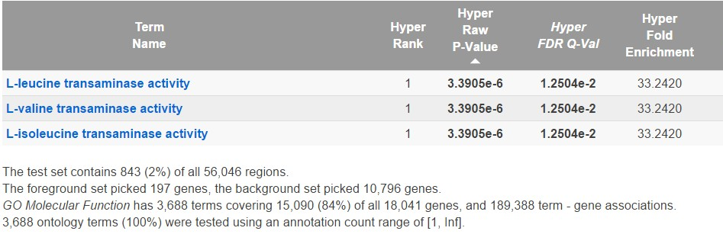
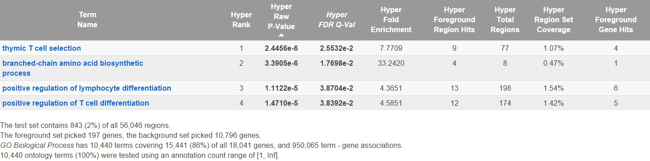
Gene ontology analysis reveal metabolism and immunology related module aberrant
GO Biological Process
metabolism
GO Cellular Component
immunology
Target: 843 significant MHL regions
Background: 50646 methylation haplotype regions

Slide 15
PCDHN (Fold enrichment=9.5, P=1.6*10⁻⁴), NKL (FE=3.5, P=1.9*10-4) and MLNR (22.16, P=2.7*10-4) gene family were significantly enriched in the differential MHL regions in RRBS dataset.

Slide 16
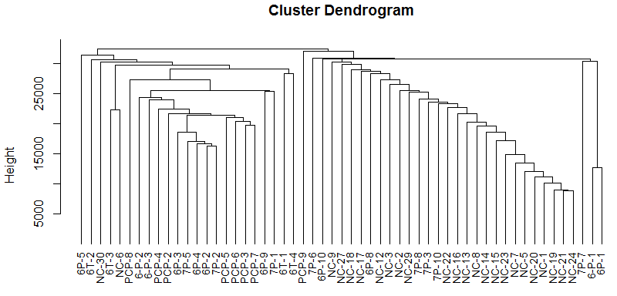
Methylation Haplotype Loading Profile in Plasma based on CapSeq
Cancer Normal
Sensitivity=67.74% Specificity=91.66%
Result: Cluster analysis based on MHL matrix of SeqCap dataset on 31 cancer and 24 normal showed the samples were clustered into two groups.
normal plasma sample have high similarity and would agglomerate together. However, some cancer samples were clustered into the normal subgroup which indicated we selected too many genome-regions which were hypermethylated both in cancer and normal tissues. In next step, we will select more specific biomarkers with feature selection operation. Cluster analysis were conducted with Manhattan distance and complete agglomeration.

Slide 17
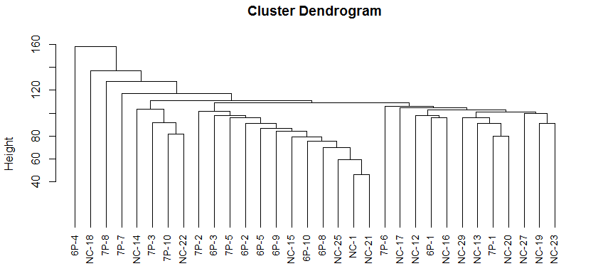
Methylation Haplotype Loading Profile in Plasma based on BSPP
P: Plasma
NC: Normal
6: Colon
7: Lung
Sensitivity=87.5% Specificity=62.5%
Result: Cluster analysis based on MHL matrix of BSPP dataset on 16 cancer plasma and 16 normal plasma showed normal plasma sample have high similarity and would agglomerate together. However, some normal plasma samples were clustered into the cancer subgroup which indicated we selected too many genome-regions which were hypermethylated both in cancer and normal tissues. In next step, we will select more specific biomarkers with feature selection operation. Cluster analysis were conducted with Manhattan distance and complete agglomeration.

Slide 18
Principle Component Analysis reveal the relationship between samples
based on Capseq dataset

Slide 19
Principle Component Analysis reveal the relationship between samples
based on BSPP dataset

Slide 20
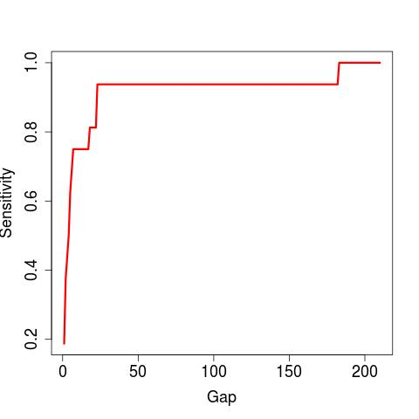
Shared hypermethylated DNA regions from RRSB and SeqCap were collected and the methylation status of these regions were validated in BSPP dataset. We need do intersection operation for 3 times and the distance (Gap) between the two regions which is less < gap were taken as the same biomarker. Obviously, Gap=25 is the best option to do the bed intersection operation.

Slide 21
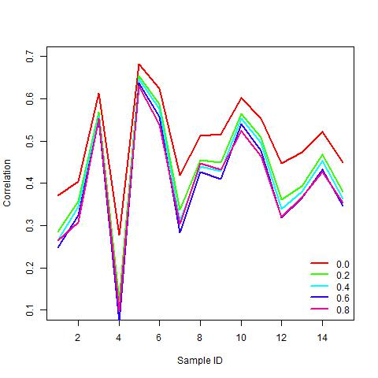
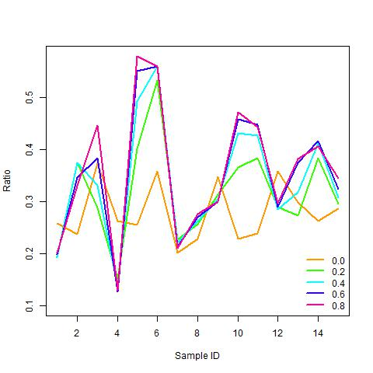
Whether DNA methylation fragments derived from cancer cells were released into the blood randomly or selectively

Slide 22
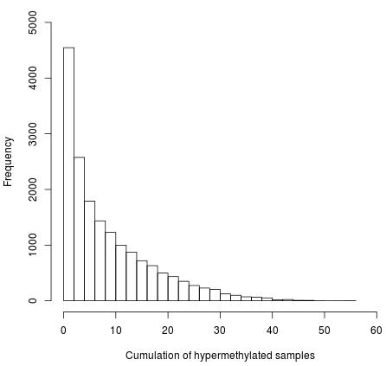
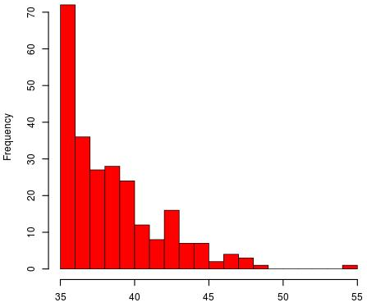
Result
248
56046
Actually, 248 hypermethylated regions occurred in at least 50% cancer samples. The average length of the regions is 103bp (IQR=95bp, SD=126). These regions located in the promoter region (TSS-2K) of 182 genes. 21 genes of them were defined as methylation relevant cancer related genes(NCBI).
TSS: Transcription Start Site; IQR: InterQuartile Range
Notes:
56046 regions were obtained by MLH algorithm and 17263 regions were 100% un-methylated in 8 normal samples. The optimal number of variables tried at each split is131(mtry) and number of trees (mtrees) makes no difference to the prediction accuracy from 500 to 7000. Random forest algorithm showed 1592 regions could provide positive ability to distinguish cancer samples from normal samples while the top 206 most importance regions could take account of 80.0% contribution, with sensitivity of 97.06%, specificity of 100% and accuracy of 97.37%. The second round prediction process of random forest model based on top 206 regions with mtry of 14 and mtrees of 500 showed 100% sensitivity, 100 specificity and 100% accuracy. One the other side, 248 regions were hypermethylated in at least 50% cancer samples. The average length of the regions were 103bp (IQR=95bp, SD=126) and were located in the promoter region of 182 genes (2000bp up-stream of TSS). With the help of text mining, 21 genes of them were validated to be methylation relevant cancer related genes (Table).

Slide 23
248
RRBS
RRBS
Cap-Seq
Cap-Seq
56046
BBSP
BBSP
RRBS
RRBS
Cap-Seq
Cap-Seq
BBSP
BBSP

Slide 24
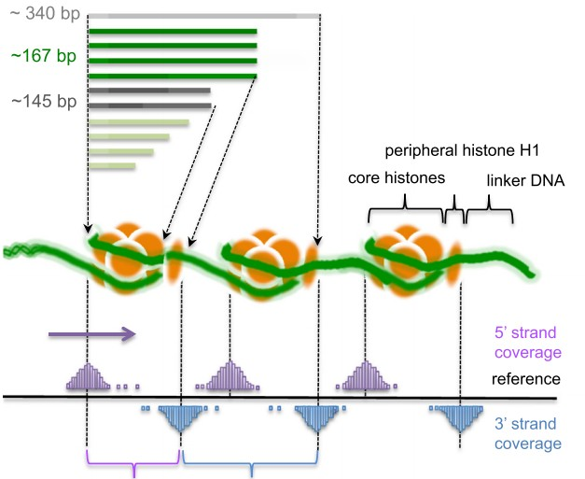
Complex mechanism of cell-free circulating DNA in human plasma
Non-random cleavage
Non-random releasing

Slide 26
Where is the methylation haplotype region?
Any significant different regions?
Random Forest
biomarker

Slide 27
Methylation Haplotype Loading Matrix

Slide 28
Enrollment
Plasma Collection
DNA extraction
Bisulfite Conversion
Sequencing
Raw Data
Alignment
Methylation LD Block
Methylation Haplotype
Loading Calculation

Slide 29
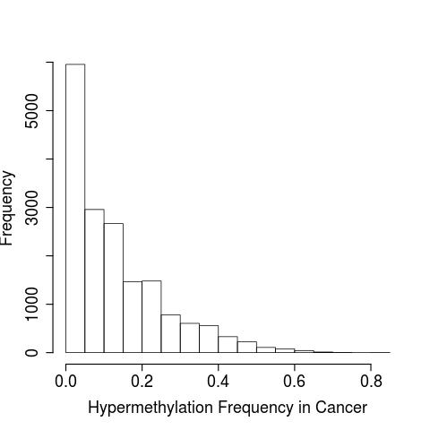
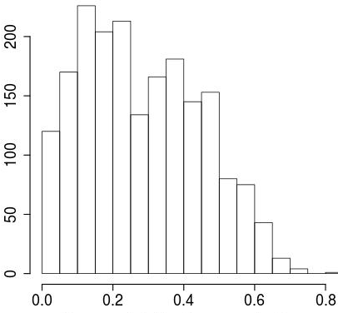
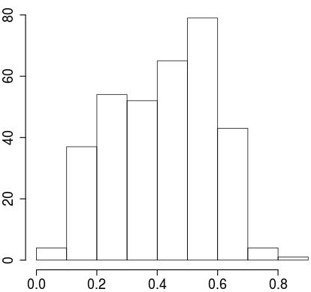

Slide 30
Table. Gene Function Enrichment analysis to 182 high frequent aberrant metylation with DAVID
Category | Term | Count | % | PValue | List Total | Pop Hits | Pop Total | Fold Enrichment | Benjamini
GOTERM_MF_FAT | transcription regulator activity | 30 | 19.48051948 | 4.63E-05 | 117 | 1512 | 12983 | 2.201702618 | 0.004415923
GOTERM_BP_FAT | regulation of transcription | 43 | 27.92207792 | 1.28E-05 | 117 | 2601 | 13528 | 1.911506751 | 0.005200761
GOTERM_BP_FAT | regulation of transcription, DNA-dependent | 34 | 22.07792208 | 9.09E-06 | 117 | 1773 | 13528 | 2.217266596 | 0.005536047
SP_PIR_KEYWORDS | dna-binding | 32 | 20.77922078 | 2.65E-05 | 148 | 1868 | 19235 | 2.226401991 | 0.006136452
GOTERM_MF_FAT | transcription factor activity | 23 | 14.93506494 | 4.46E-05 | 117 | 975 | 12983 | 2.617655052 | 0.006374167
GOTERM_BP_FAT | regulation of RNA metabolic process | 35 | 22.72727273 | 5.33E-06 | 117 | 1813 | 13528 | 2.232122232 | 0.006488715
GOTERM_MF_FAT | sequence-specific DNA binding | 18 | 11.68831169 | 2.65E-05 | 117 | 607 | 12983 | 3.29058421 | 0.007565542
SP_PIR_KEYWORDS | Homeobox | 10 | 6.493506494 | 1.04E-04 | 148 | 242 | 19235 | 5.370504802 | 0.011981548
SP_PIR_KEYWORDS | transcription regulation | 31 | 20.12987013 | 2.86E-04 | 148 | 2026 | 19235 | 1.988624236 | 0.021885309
SP_PIR_KEYWORDS | Transcription | 31 | 20.12987013 | 4.16E-04 | 148 | 2071 | 19235 | 1.945414149 | 0.023850767
INTERPRO | Homeobox | 10 | 6.493506494 | 1.87E-04 | 143 | 235 | 16659 | 4.957298021 | 0.03112568
GOTERM_BP_FAT | positive regulation of macromolecule biosynthetic process | 16 | 10.38961039 | 4.62E-04 | 117 | 654 | 13528 | 2.82872004 | 0.04592463
GOTERM_BP_FAT | positive regulation of nitrogen compound metabolic process | 16 | 10.38961039 | 3.93E-04 | 117 | 644 | 13528 | 2.872644264 | 0.046847505
GOTERM_BP_FAT | negative regulation of macromolecule metabolic process | 17 | 11.03896104 | 5.16E-04 | 117 | 734 | 13528 | 2.677938471 | 0.047376266
GOTERM_BP_FAT | positive regulation of gene expression | 15 | 9.74025974 | 4.43E-04 | 117 | 581 | 13528 | 2.985127322 | 0.048057813

Slide 31
Figure 1. High frequent aberrant hypermethylated genes in RRBS dataset
 | Gene Symbol | Gene ID |  | Chrosome | Start | End | orientation | exon_count | OMIM
1 | JAM3 | 83700 | 11q25 | 11 | 134068925 | 134151757 | plus | 9 | 606871
2 | TMEFF2 | 23671 | 2q32.3 | 2 | 191949046 | 192194940 | minus | 10 | 605734
3 | MTSS1 | 9788 | 8p22 | 8 | 124550770 | 124728507 | minus | 19 | 608486
4 | L3MBTL1 | 26013 | 20q13.12 | 20 | 43507680 | 43541895 | plus | 22 | 608802
5 | IRF4 | 3662 | 6p25-p23 | 6 | 391739 | 411443 | plus | 10 | 601900
6 | CCDC181 | 57821 | 1q24 | 1 | 169394870 | 169460669 | minus | 8
7 | IGF2 | 3481 | 11p15.5 | 11 | 2129112 | 2149603 | minus | 9 | 147470
8 | IGF2-AS | 51214 | 11p15.5 | 11 | 2140528 | 2148666 | plus | 2 | 610146
9 | CCNA1 | 8900 | 13q12.3-q13 | 13 | 36431030 | 36442882 | plus | 11 | 604036
10 | GATA2 | 2624 | 3q21.3 | 3 | 128479422 | 128493187 | minus | 8 | 137295
11 | NTRK2 | 4915 | 9q22.1 | 9 | 84668458 | 85027070 | plus | 23 | 600456
12 | DLEC1 | 9940 | 3p21.3 | 3 | 38038605 | 38122737 | plus | 38 | 604050
13 | ALX4 | 60529 | 11p11.2 | 11 | 44260438 | 44319220 | minus | 7 | 605420
14 | CBX3 | 11335 | 7p15.2 | 7 | 26201211 | 26213607 | plus | 8 | 604477
15 | CYP26B1 | 56603 | 2p13.2 | 2 | 72129238 | 72147862 | minus | 8 | 605207
16 | NFATC1 | 4772 | 18q23 | 18 | 79395772 | 79529323 | plus | 11 | 600489
17 | DNMT3A | 1788 | 2p23 | 2 | 25232961 | 25342590 | minus | 33 | 602769
18 | ITGA4 | 3676 | 2q31.3 | 2 | 181456892 | 181537747 | plus | 28 | 192975
19 | GATA4 | 2626 | 8p23.1-p22 | 8 | 11676924 | 11760001 | plus | 12 | 600576
20 | SLC5A5 | 6528 | 19p13.11 | 19 | 17871411 | 17895174 | plus | 16 | 601843
21 | PHACTR3 | 116154 | 20q13.32-q13.33 | 20 | 59577509 | 59847711 | plus | 18 | 608725

Slide 32
Intra-data Validation:
½ RRBS sample as train dataset and ½ RRBS sample as test dataset with 2-fold cross-validation
Inter-data Validation:
RRBS dataset as train dataset and BSPP data as test dataset
Total Dataset with imputation
RRBS, BSPP, * and * were merged and missing value were imputed by KNN imputation
Random Forest with 5-fold cross-validation were applied in classification

Slide 33
The mutation ratio for significant genes are very high, ranging from 2.43% to 47.57%. However, the mutation rate for specific site is very low, there are up to 139 mutations in TP53 occurred in 196 patients, each patients have 1.41 mutations.
Gene | All Samples (n=412) # mutated patients | All Samples (n=412) # mutated sites | p-value | q-value | Bonferroni p-value | Mutation Patient Ratio | Mutation Sites/Patients
TP53 | 196 | 139 | 1.00E-16 | 4.05E-13 | 1.83E-12 | 47.57% | 1.41
KRAS | 115 | 9 | 1.00E-16 | 4.05E-13 | 1.83E-12 | 27.91% | 12.78
EGFR | 64 | 40 | 1.00E-16 | 4.05E-13 | 1.83E-12 | 15.53% | 1.60
STK11 | 64 | 53 | 1.00E-16 | 4.05E-13 | 1.83E-12 | 15.53% | 1.21
RBM10 | 30 | 29 | 1.11E-16 | 4.05E-13 | 2.03E-12 | 7.28% | 1.03
CDKN2A | 18 | 16 | 2.99E-14 | 8.60E-11 | 5.46E-10 | 4.37% | 1.13
KEAP1 | 61 | 58 | 3.30E-14 | 8.60E-11 | 6.02E-10 | 14.81% | 1.05
BRAF | 36 | 22 | 5.11E-12 | 1.17E-08 | 9.33E-08 | 8.74% | 1.64
U2AF1 | 13 | 2 | 1.74E-11 | 3.53E-08 | 3.18E-07 | 3.16% | 6.50
SMARCA4 | 33 | 34 | 3.13E-11 | 5.71E-08 | 5.71E-07 | 8.01% | 0.97
NF1 | 45 | 52 | 4.83E-11 | 8.02E-08 | 8.82E-07 | 10.92% | 0.87
MET | 24 | 22 | 9.67E-10 | 1.47E-06 | 1.77E-05 | 5.83% | 1.09
ARID1A | 31 | 34 | 1.47E-09 | 2.06E-06 | 2.68E-05 | 7.52% | 0.91
SETD2 | 29 | 37 | 1.73E-09 | 2.25E-06 | 3.16E-05 | 7.04% | 0.78
RB1 | 16 | 16 | 1.54E-08 | 1.88E-05 | 0.000281096 | 3.88% | 1.00
PIK3CA | 23 | 13 | 8.24E-08 | 9.40E-05 | 0.001504047 | 5.58% | 1.77
MGA | 25 | 29 | 5.35E-07 | 5.74E-04 | 0.009765355 | 6.07% | 0.86
RIT1 | 10 | 8 | 1.07E-06 | 1.09E-03 | 0.01953071 | 2.43% | 1.25
Comprehensive molecular profiling of lung adenocarcinoma. Nature. 2014, 511(7511):543-50

Slide 34
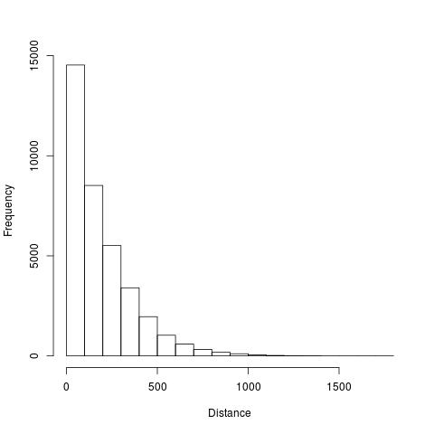
Histogram distribution of the MHL regions of BSPP dataset. 63.4% MHL distance of BSPP were less than 200bp, indicating they are almost located in the same region/CpG island in human genome, therefore, we need merge these MHL region together to increase the sensitivity of the prediction. In other words, when can do bed intersection operation wth certain gaps so that these regions can be selected.

Slide 35
Haplotype -> Methylation Haploptye
LD -> Methylation LD
Tag SNPs -> Tag Methylation Loci (TML)

Slide 36
Acknowledgment
Dinh Diep
Nongluk (Noi) Plongthongkum

